Slide 1
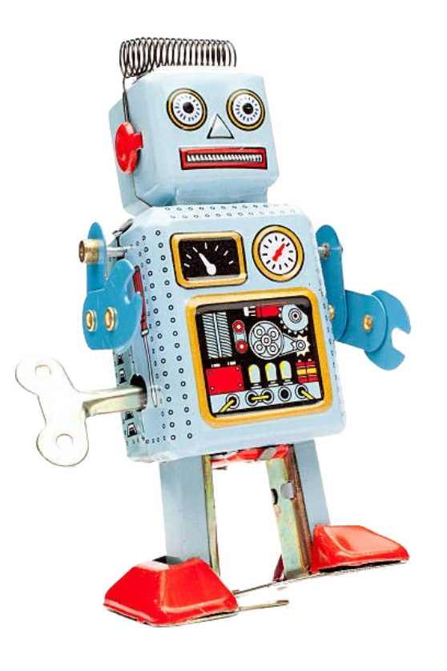
Team 19
NASA Lunabotics Competition
Ryan Cheng Joseph Folen Landon Reynolds Maxwell Thursby Blake Williams Kevin Zheng

Slide 2
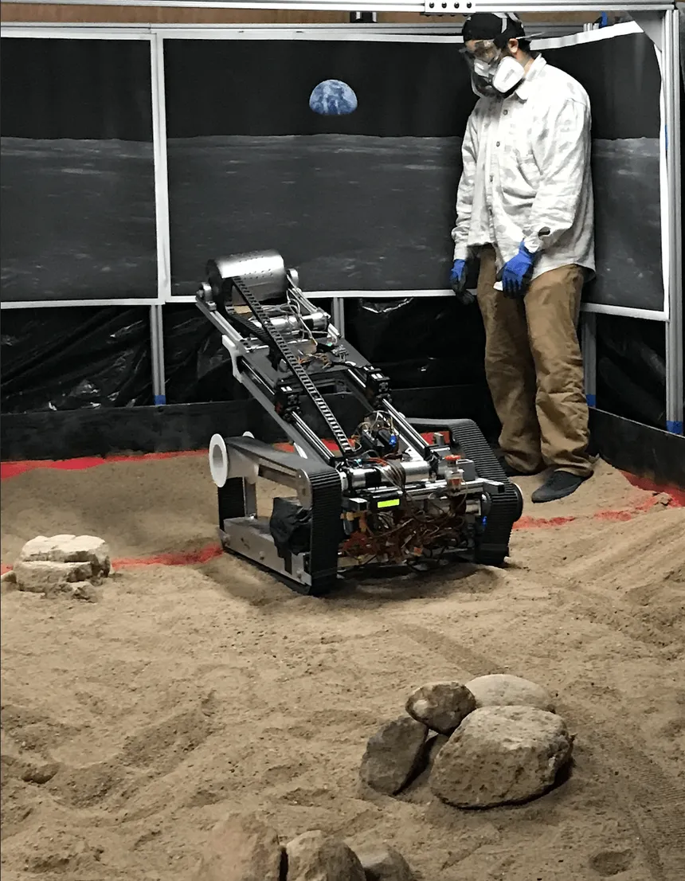
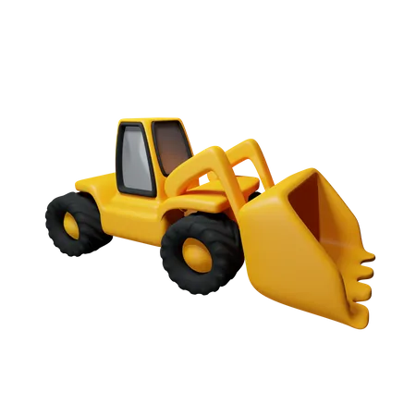

Abstract
NASA holds an annual lunabotics competition, where schools nationwide compete to build the best lunar robotics system
Previous years’ robots have faced significant challenges
Our goal for this year is to fix as many of the past mistakes as possible

Slide 3

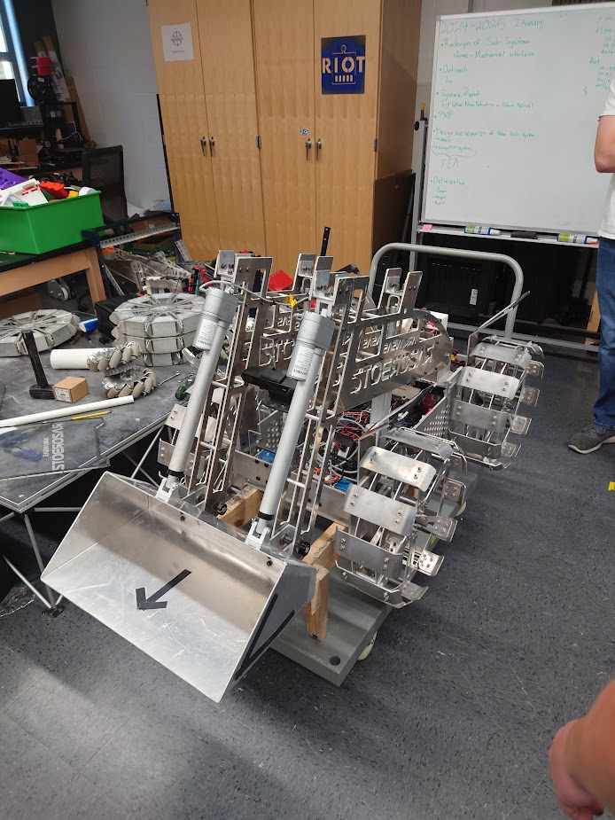
Problem
Unreliable communication system
Electromagnetic interference
Cumbersome robot testing
Unsatisfactory GUI
No additional cameras for arena awareness
heavy

Slide 4

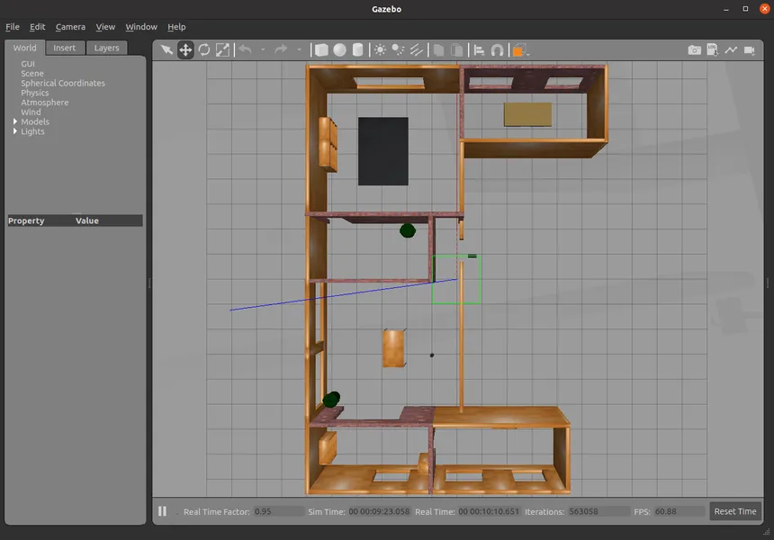
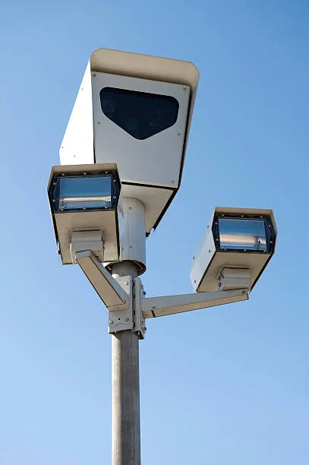
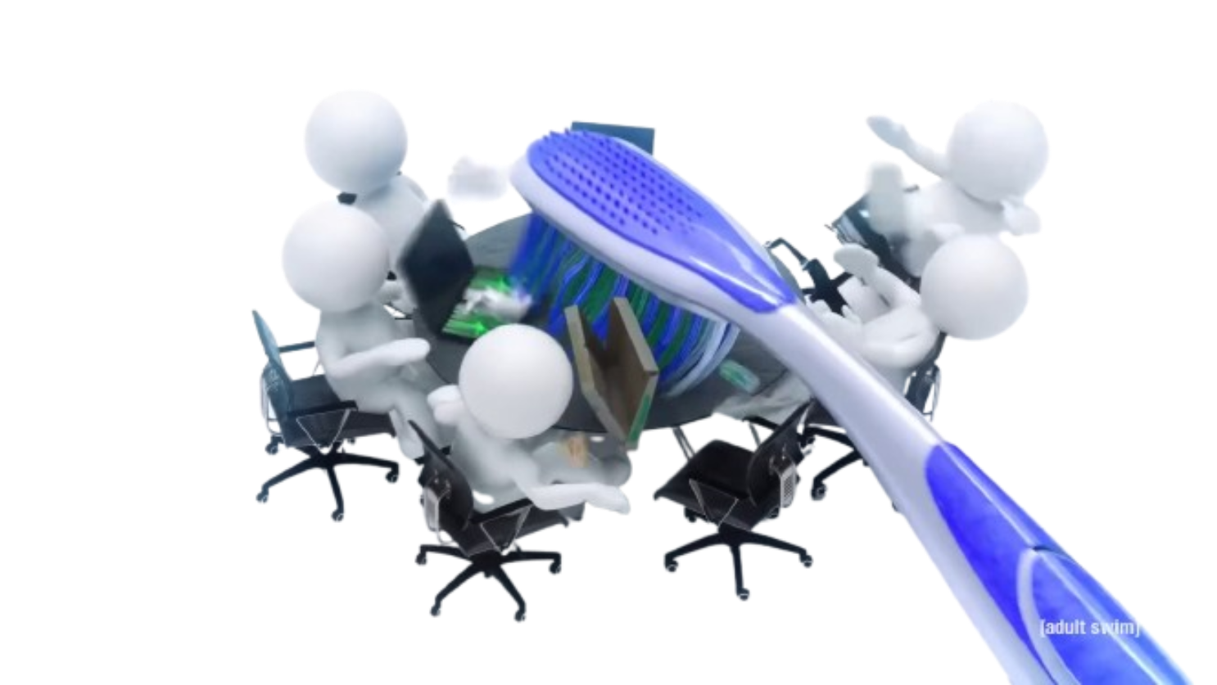
Objective
Update communications systems
Build a comprehensive simulation
Implement full autonomy using stereo camera system
Adjust the GUI to make information easier to read
Implement deployable awareness camera

Slide 5
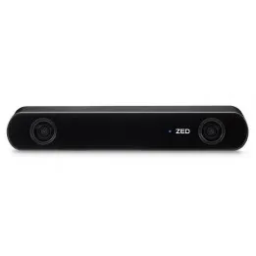
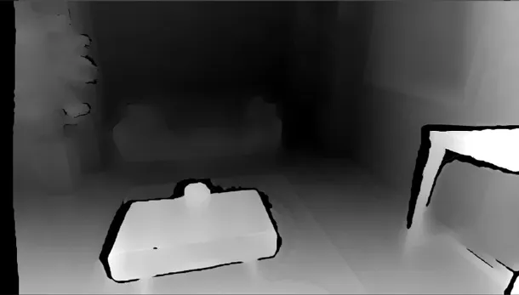
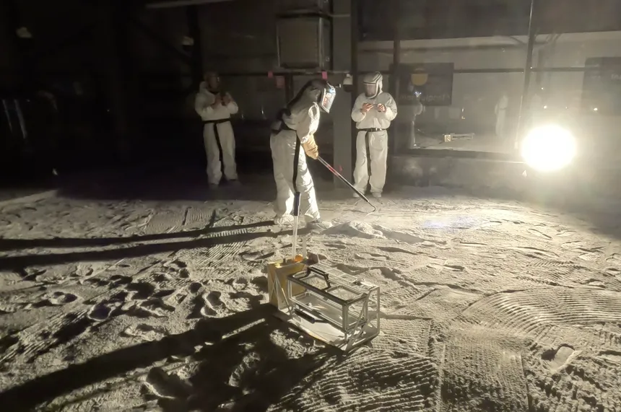
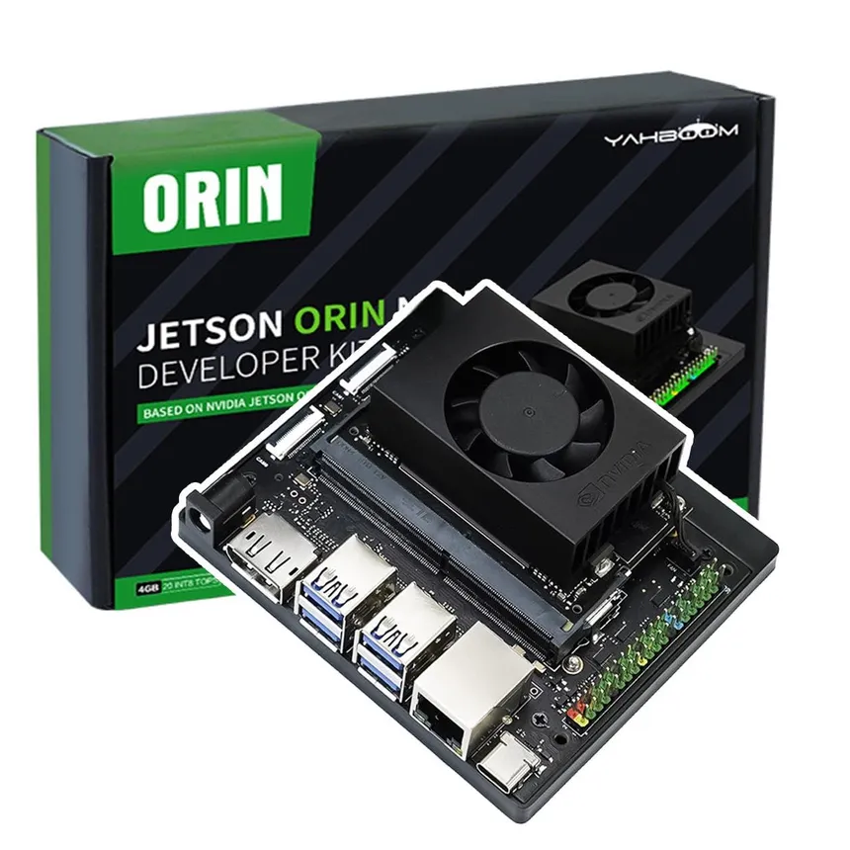

Background
Key Concepts
BP-1, ROS2, Jetson Orin Nano, CAN Bus, ROS Gazebo, GTKMM, ZED API, UDP
Related Work
Previous years’ robots
Skinny
Spinner
Scoop
Shovel

Slide 6
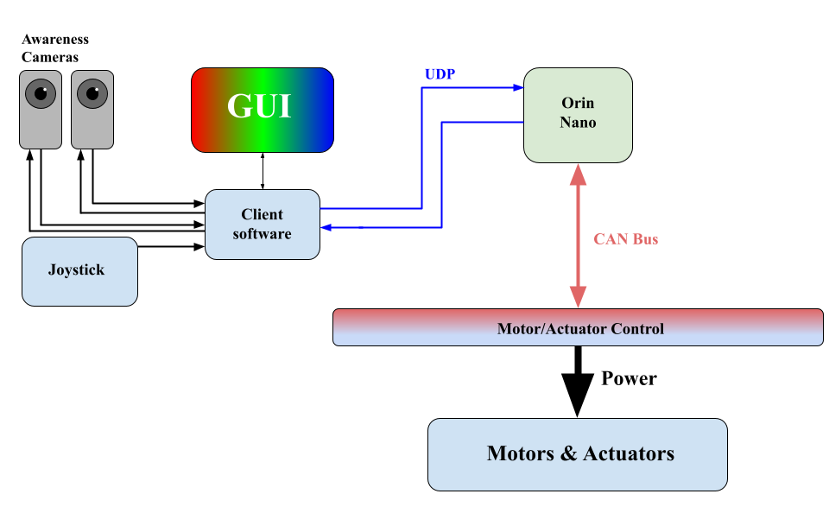

Use Cases
Fully autonomous but can be controlled (WiFi)
Camera feed for navigation
Driver can take control using the joystick.

Slide 7

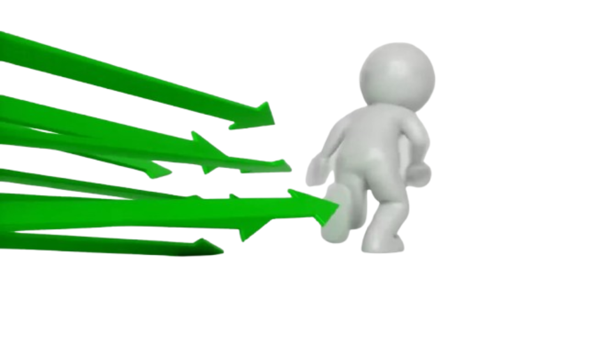
Requirements
Robot dimensions, maximum mass, and navigation
The robot should be autonomous to help gain extra points
The robot needs to have a bucket to pick up piles of dirt
The robot must avoid any obstacles during testing and the competition
Joystick that allows basic driving controls and bucket movement
Runtime requirement that the robot must achieve during the competition and testing

Slide 8

Key Personnel
Ryan Cheng – responsible for refinement of the GUI
Joseph Folen – responsible for revising the communication system and protocols for improved reliability
Landon Reynolds – responsible for refinement of the GUI
Maxwell Thursby – responsible for the implementation of the simulation software and optimization of the electrical components of the robot
Blake Williams – responsible for revising the communication system and protocols for improved reliability
Kevin Zheng – responsible for the implementation of the simulation software and optimization of the electrical components of the robot

Slide 9
Questions?

